Slide 1
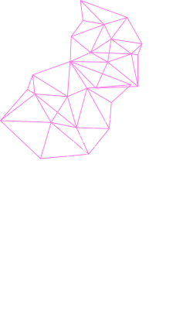



Page 1
Transfer Learning in AI
Pre-trained Models
Presented to
Dr. Rodrigue Imad
Presented By:
Omar Houssein
Mario Makhlouta

Slide 2
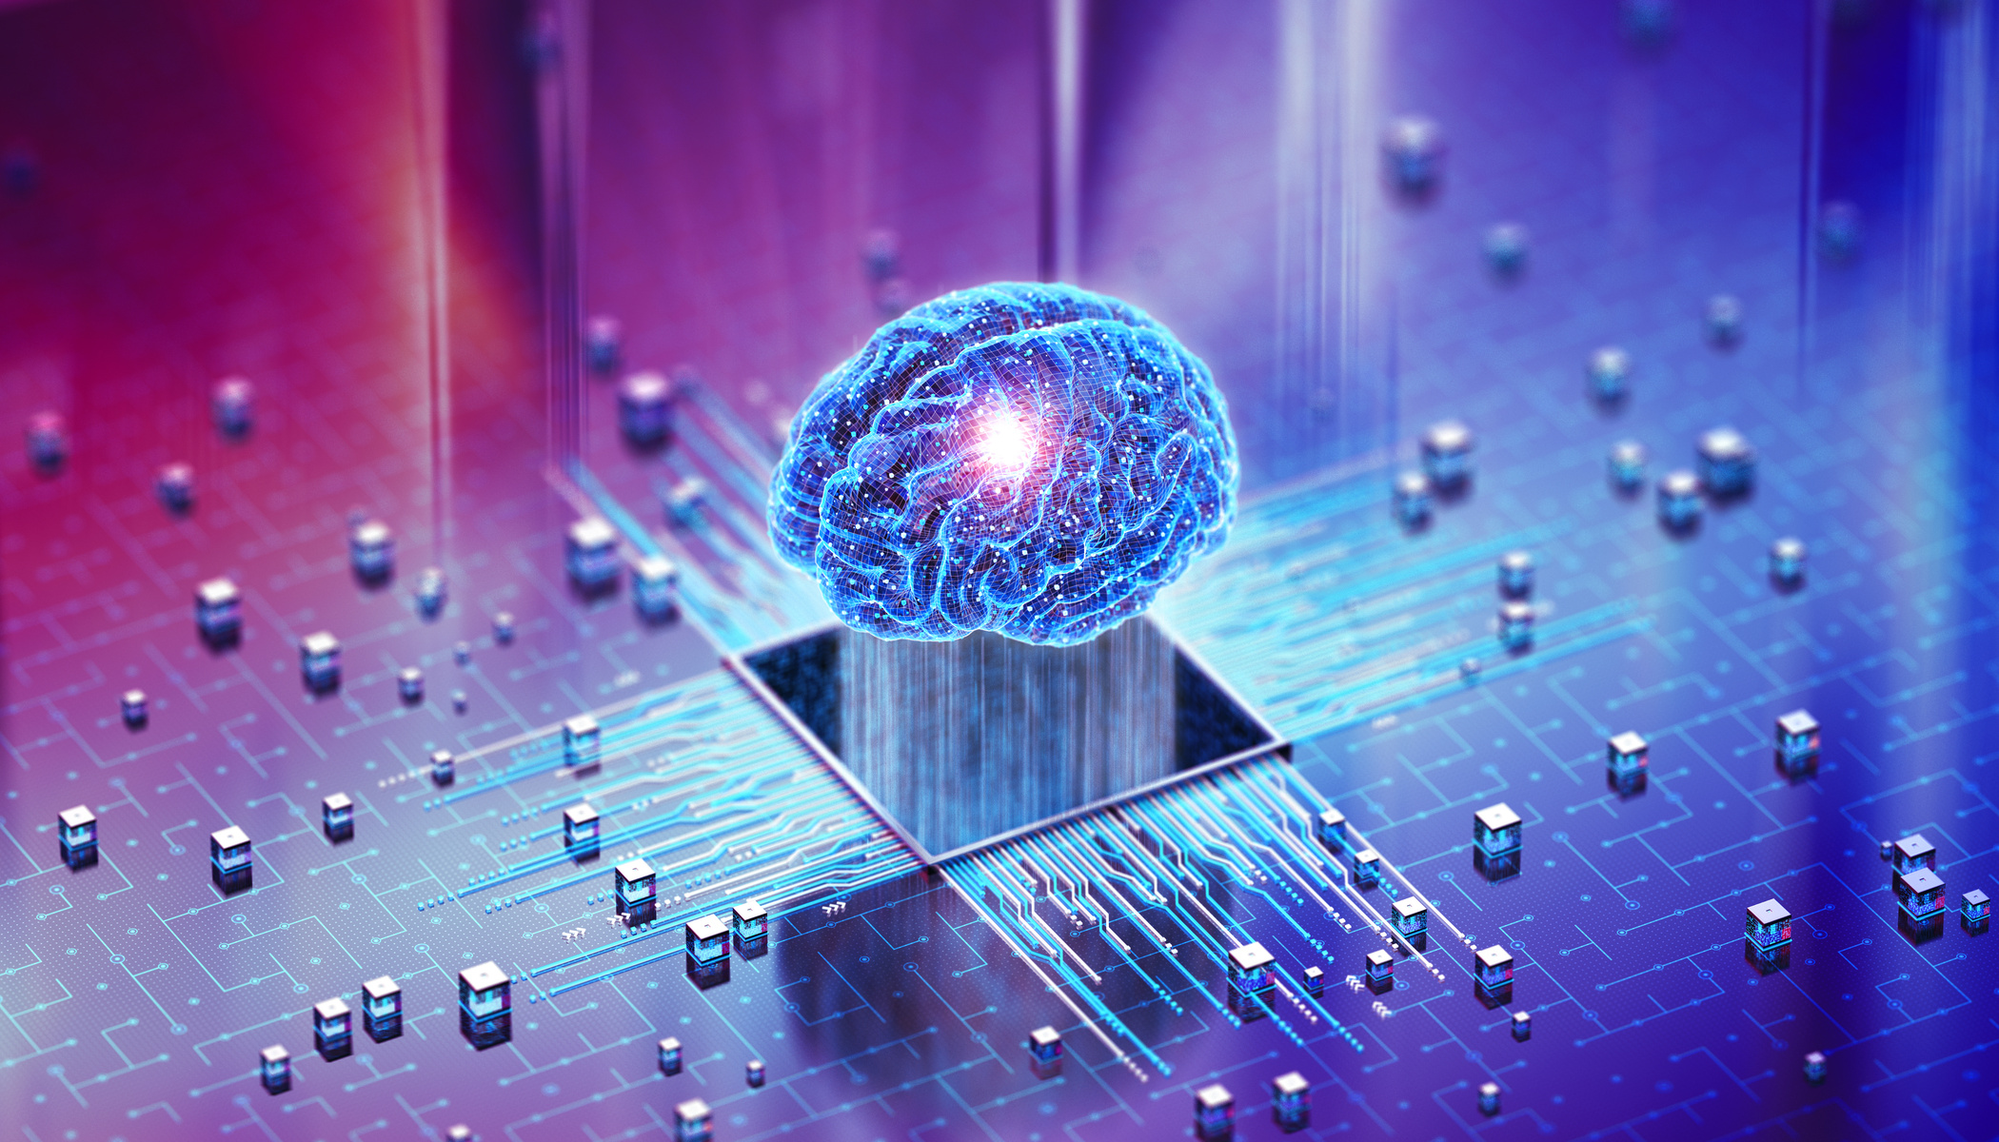
Page 2
The Problem (Training From-Scratch)
Requires massive datasets and high computing power.
Training from zero is expensive and incredibly slow.
Real-world engineering tasks rarely have enough labeled data.
Introduction to Transfer learning in AI

Slide 3
Page 3
What is
Transfer Learning in AI ?
Reusing knowledge from a solved task to accelerate a new one.
Adapts pre-trained models using minimal new data.
Analogy: Piano skills transfer to learning the organ much faster.
Introduction to Transfer learning in AI

Slide 4



Page 4
What is Being Transferred?
Transferred: Features (edges, shapes), model weights, and early layer patterns.
When to Use It
Target datasets are small or expensive.
Compute budgets are strictly limited.
Source and target tasks are related.

Slide 5

Page 5
Timeline
Evolution
2010:
The math is standardized: Pan & Yang publish the landmark survey defining the modern taxonomy.
2013:
NLP’s first step: Word2Vec is introduced, allowing semantic meaning to be transferred across text.
2020:
The Zero-Shot Era: GPT-3 proves foundation models can transfer knowledge through prompts alone.
1993:
The theoretical birth: Pratt formally introduces "Transfer Learning" to neural networks.
2012:
The Vision Revolution: AlexNet proves pre-trained CNNs can act as universal feature extractors.
2018:
The "BERT Moment": Transformers make massive pre-training and fine-tuning the gold standard.

Slide 6






Page 6
Importance of
Transfer Learning
~10x Less Data: drastically reduces labeling needs
3-5x Faster Deployment: accelerates engineering cycles.
~70% Compute Savings: slashes GPU training costs.

Slide 7

Page 7
Catastrophic
Engineering Solutions:
Forgetting
Layer Freezing: Disable weight updates entirely
(requires_grad = False).
The Problem:
New training overwrites pre-trained knowledge.
The model "forgets" its original foundation.
Differential Learning Rates:
Base model: Microscopic rate
New head: Standard rate

Slide 8
Page 8
How Transfer Learning Works
Select Model
Remove Head
Freeze Early Layers
Train New
Choose a large pre-trained base.
Replace the final task-specific layer.
Lock in general feature knowledge.
Adapt the new head on target data.

Slide 9
Page 9
Types of Transfer Learning
Inductive
Transductive
Unsupervised
Domain Adaptation
Different tasks, labeled target data available.
Same task, different domains.
No labeled data in either domain.
Bridging distribution shifts.

Slide 10

Page 10
Components of Transfer Learning
Domains: Source (origin) and Target (new application).
Pre-trained Model: Deep network holding general knowledge.
Feature Extractor: Frozen layers retaining reusable patterns.
Adaptation Method: Fine-tuning the new task head.

Slide 11




Page 11
Traditinal ML Vs
Transfer Learning
DIMENSION
Traditional ML
Transfer Learning
Initial State
Random Weights ( Cold Start)
Pre-trained weights ( warm start)
Data Needed
Massive Labeled Dataset
Minimal Labeled Samples
Traning Time
Long ( Weeks / Days )
Short ( Hours / Minutes )
Cost Intensity
High Compute Resources
Optimized Efficiency

Slide 12





Page 12
Popular Pretrained Models & Applications
Computer Vision
Natural Language (NLP)
Multimodal
ResNet, VGG, Inception, EfficientNet, Vision Transformers (ViT).
BERT, GPT-3/4, T5, RoBERTa, CLIP.
DALL·E, Flamingo, LLaVA.
Healthcare
Autonomous Systems
Finance

Slide 13

Page 13
Advanced Techniques
Self-Supervised Pretraining
Few/Zero-Shot Learning
Multi-Task Learning
Generalizing from <= 5 or zero examples.
Training on multiple related tasks jointly
Learning from completely unlabeled data.

Slide 14

Page 14
Deep Transfer Learning
Early Layers (Frozen): Basic patterns like edges or syntax.
Middle Layers (Partial): Mid-level semantic structures.
Final Layers (Trained): Task-specific target output.

Slide 15


Page 15
Advantages Vs
Disadvantages
Advantages
Disadvantages
higher accuracy
Domain mismatch risks
Minimal Data
inherited biases
Faster traning
high base compute costs

Slide 16

Page 16
Challenges and Limitations
Distribution Shifts: Generalizing across varying domains is tough.
Overfitting: Small target datasets risk memorization.
Generalization: Balancing broad knowledge with specific tasks.

Slide 17
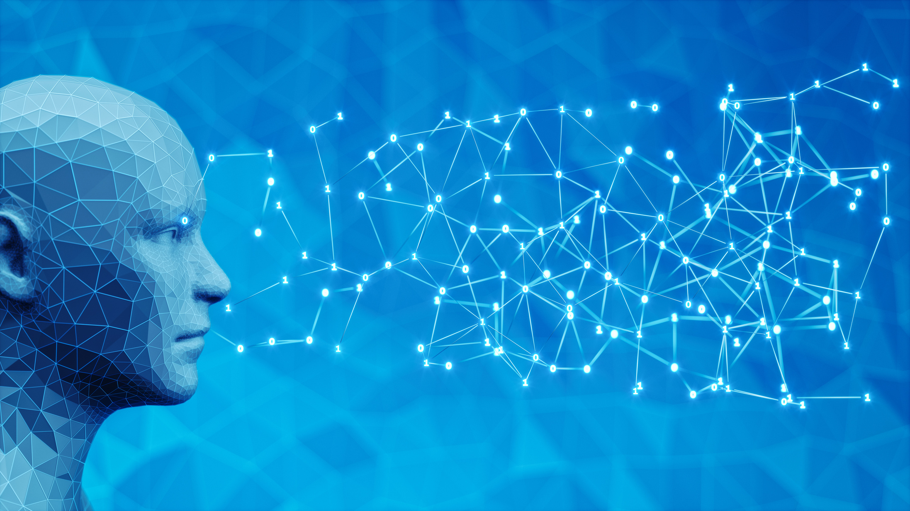
Page 17
Negative
The Consequence
Transfer
The model achieves worse accuracy than if it were just trained from scratch.
What is it?
Why it Happens
Negative transfer occurs when source task knowledge actively harms performance on the target task
Source and target tasks are too different.
Data distributions are not aligned.
The Solution: Requires careful model benchmarking and proper data selection.

Slide 18





Page 18
Tools, Frameworks &
Current Tools
Standard Tools
Current Trends
TensorFlow / Keras: High-level APIs with extensive pretrained model hubs.
Massive Foundation models and GPT architectures.
PyTorch / TorchVision: Flexible research frameworks with built-in pretrained CNNs.
Self-supervised learning on unprecedented scales.
Hugging Face: The community standard for BERT, GPT, and vision transformers.

Slide 19
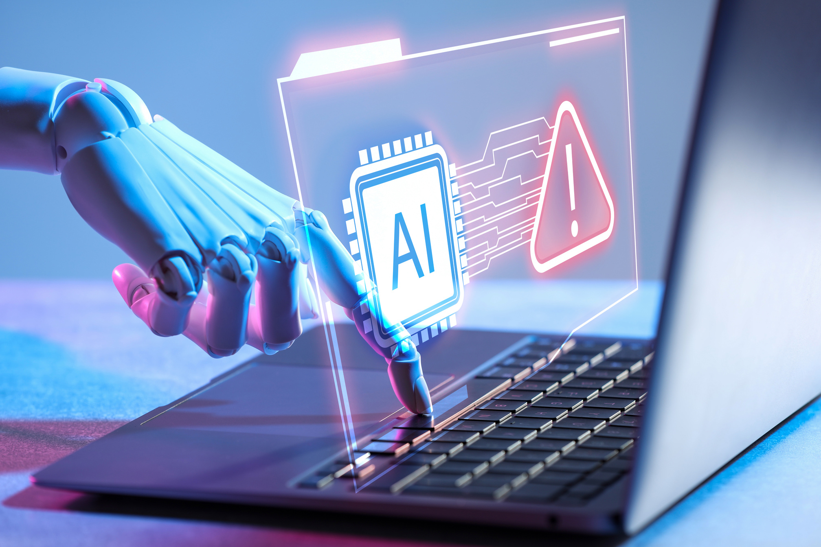
Page 19
Future of Transfer
Learning
Efficiency: Moving toward more efficient fine-tuning methods like LoRA (Low-Rank Adaptation) and adapters.
Generalization: Better handling of zero-shot adaptation across vastly different domains.
Safety: Intensive research into reducing inherited biases and improving alignment robustness.
The Ultimate Goal: Moving toward more general-purpose AI systems (AGI).

Slide 20
Page 20
Conclusion
Efficient Technique: Drastically reduces data, computing, and training time requirements.
Scalable: Widely used in the real world across vision, NLP, speech, and robotics.
Powerful: Achieves state-of-the-art performance, provided there is sufficient task similarity and careful fine-tuning.
Bottom Line: It reduces costs and makes AI development practical.

Slide 21

Page 21
Thank
You
References:
Pan, S. J., & Yang, Q. (2010). A Survey on Transfer Learning. IEEE Transactions on Knowledge and Data Engineering, 22(10), 1345–1359.
IBM Think: What is Transfer Learning?
AWS: What is Transfer Learning?
GeeksforGeeks: Introduction to Transfer Learning
Hugging Face: Transformers Fine-tuning Documentation
PyTorch / TorchVision Pretrained Models
TensorFlow / Keras Transfer Learning Guide

